Slide 1
Objectives
In this session, you will learn to:
  Process professional tax
  Generate payroll reports

Slide 2
Payment of Professional Tax
The Professional Tax is applicable to those individuals or professionals in India who are involved in any profession or trade.
The state government of each state governs and administers the levy and collection of Professional Tax in the respective State.
The state is empowered with the responsibility of structuring as well as formulating the professional tax criteria for the respective state.
Professional tax is charged on the incomes of Individuals, profits of business or gains in vocations as per the list II of the Indian Constitution.

Slide 3
Demo: Processing Professional Tax Payment
Problem Statement:
  On 30th April, 2009 M/s. Indus Solutions Pvt. Ltd., made payment of Professional Tax for the month of April 2009.

Slide 4

Demo: Processing Professional Tax Payment (Contd.)
Let us see how to process the professional tax payment in Tally.ERP 9.

Slide 5
Generating Payroll Reports
Payroll reports help you to ascertain the payroll expenses for a specified month or for year-to-date (YTD) transactions for a particular employee or group along with the attendance and production details.
In Tally.ERP 9, the payroll reports can be broadly classified into the following categories:
  Payroll Reports
  Payroll Statutory Reports

Slide 6
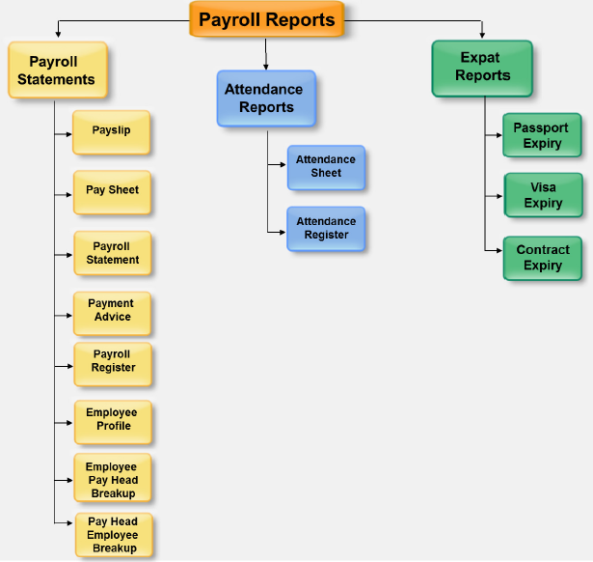
Payroll Reports
The following figure shows the various Payroll reports.

Slide 7
Payslip
Payslip:
  Refers to a document issued to an employee.
  Itemises each component of his or her earnings and deductions and the net amount paid for a given pay period.
  Provides particulars on how the net amount has been arrived at.

Slide 8
Demo: Displaying, Printing and Mailing Payslip
Let us see how to display, print and mail Payslip in Tally.ERP 9.

Slide 9
Demo: Exporting Payslip to MS Excel
Let us see how to export Payslip fron Tally.ERP 9 to MS Excel.

Slide 10
Pay Sheet
Pay Sheet:
  Is a columnar report which displays the group-wise or department-wise employees’ breakup of earnings and deductions for the selected month.

Slide 11
Demo: Displaying Pay Sheet
Let us see how to display Pay Sheet in Tally.ERP 9.

Slide 12
Payroll Statement
Payroll Statement:
  Is a columnar report which displays group-wise or
  department-wise employees’ break-up of selected earnings or deductions, for a specified month or period.

Slide 13
Demo: Displaying Payroll Statement
Let us see how to display Payroll Statement in Tally.ERP 9.

Slide 14
Summary
In this session, you learned that:
  Payslip is a document, issued to an employee, that itemises each component of his or her earnings and deductions.
  Pay Sheet is a matrix report with details of pay heads pertaining to employees.
  Payroll Statement helps to generate reports for specific pay heads.

